Slide 1


Coaching for Leaders
NJ Family Success Centers’ Kick off
March 29, 2019

Slide 2

Welcome______________________________

Slide 3

Project Purpose
To provide support to Family Success Center Leadership in their coaching of FSC talent
To provide a strong conceptual basis, tools and opportunities to practice new approaches in Coaching for Leaders
To assist with ongoing integration of the Practice Profile into existing FSC systems
To provide tools, resources, and a consistent self-directed system for teaching & application for the FSC talent about the Essential Functions

Slide 4

Project Objectives
Increase participants’ understanding of the role and benefit of the “coaching skill” for a leader and enhance their ability to develop others & shape desired behavior
Through heightened self-awareness, provide opportunities for participants to learn how to execute coaching methodology that brings about behavioral change in themselves, others and the system for full Practice Profile integration

Slide 5
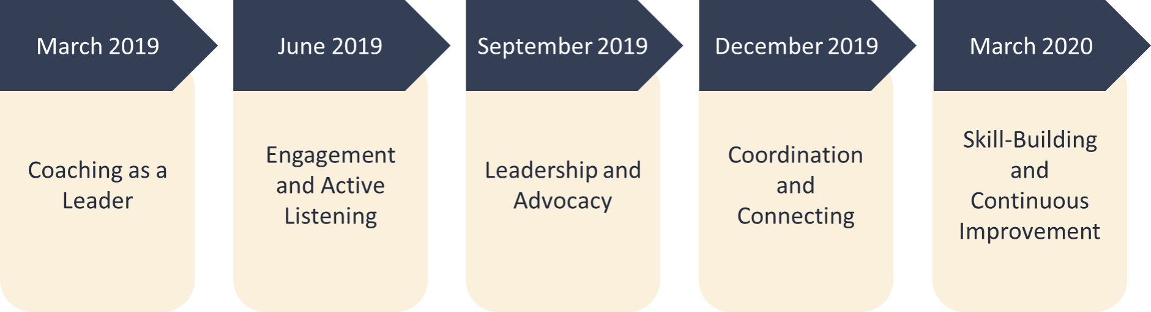
Project Timeline______________________

Slide 6


Future Design
Coaching Skills
Are
Check In
Coaching Skill
Essential Function
Key to Teaching the Essential Functions
Self-Directed

Slide 7

Coaching Definition
Coaching is a key element for encouraging growth and development.
It has a clearly defined strategic intent – to develop the individual’s ability to perform in an effective, empowered manner while performing the work of the organization. Coaching is helping others to identify their own attributes and to understand their behavioral strengths and developmental needs. All through their efforts to help, coaches share their own experience and ideas openly. Coaching is usually more generative than remedial. It is a way of communicating, a way of doing business in the process of the work environment. In that sense, coaching is not an “event”. It is practiced as part of the work and communication process, responding to issues as they present themselves and integrating development with getting the job done right. Coaching is concerned with building capacity and helping people to solve the problems at hand.
www.perrone-ambrose.com

Slide 8


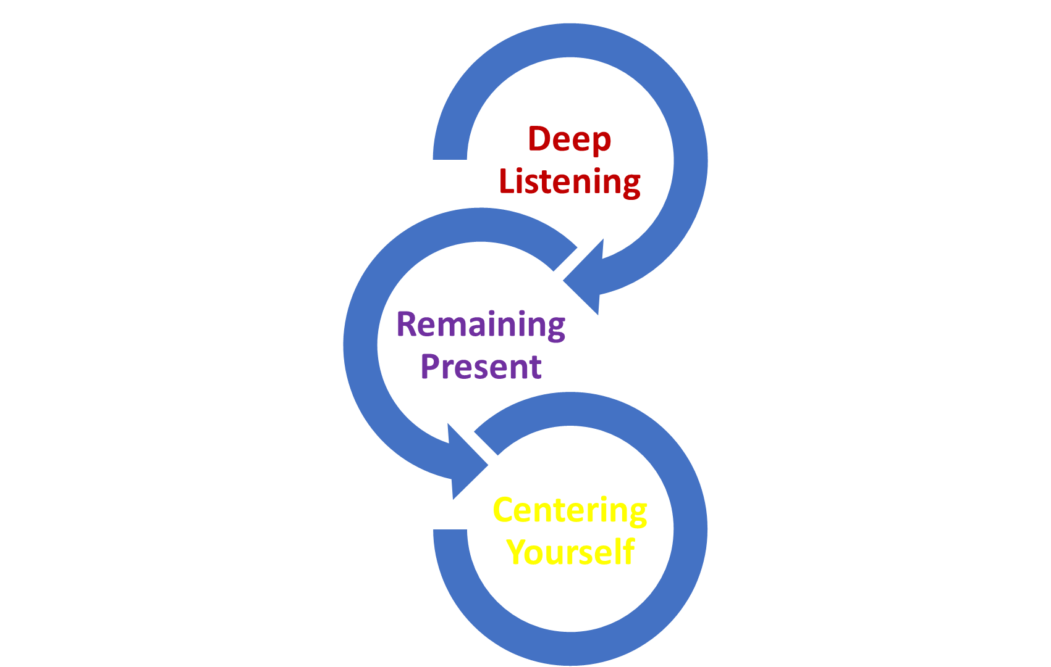

Slide 9

Desired Outcomes for Todays Session
Introduction to Coaching for Leaders
Connect the concept/belief that “coaching” is key to new learning and sustainability
Learn key definitions and link to Family Success Center Culture and Practice Profile
Introduction to and beginning foundation practice of Coaching skills
Connect Coaching skills to Self-Directed learning

Slide 10


9:00 Welcoming – Introduction to the Day
10:00 Mini World Cafe
11:00 Break (Enjoy ☺)
11:15 Why Ask (Coaching Foundation)
12:00 Lunch (Enjoy & Rejuvenate ☺)
12: 30 The Compass for Mentoring & Coaching ©(Perrone-Ambrose)
2:00 Break (Enjoy ☺)
2:15 Coaching Round Robin
3:00 Self-Directed Work
3:20 Conclusion
3:30 Adjourn-Thank You

Slide 11

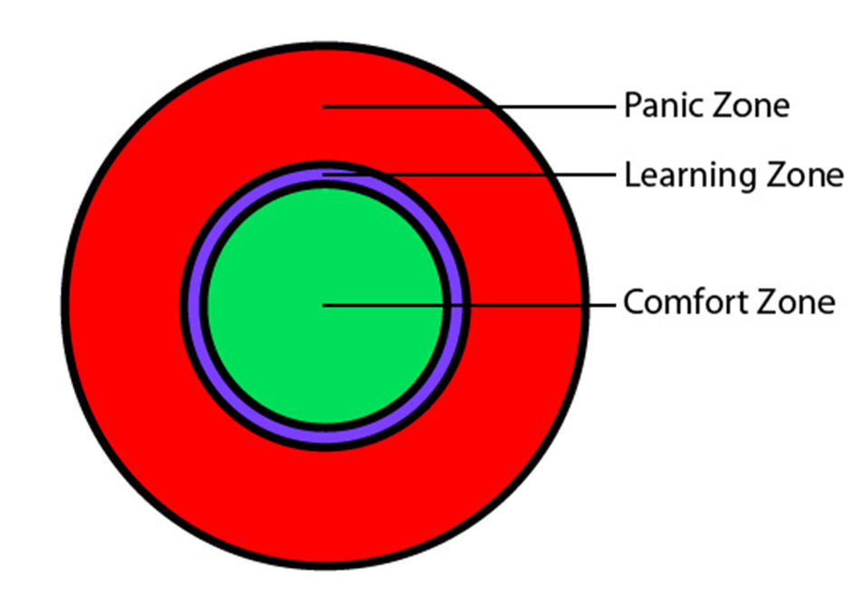


Ideal Learning Zone____________________

Slide 12


______Training …versus… learning_____
PUSH SYSTEM
PULL SYSTEM

Slide 13

World cafe
You are Invited to our Communication Café:
Be Creative
Doodle
Have Fun

Slide 14

Break

Slide 15

Why Ask
Coaching Foundation

Slide 16

What Benefits Come From Asking Great Questions ?

Slide 17

If You want to change Results
Change the Questions
- unknown
Results
Different Results Desired
Change Questions
Results

Slide 18

The Power of Great Questions
Questions Hold the Power to cause us to think
Questions have the power to create answers we believe in
Motivate us to act on our ideas
Move us beyond passive acceptance of what others say and believe
Questions redefine relationships between people

Slide 19


Why ask appreciative questions?
Why Ask?
Why Ask?
All the information is with the Coachee
Asking Creates Engagement
Asking Empowers
Asking Develops Leadership Capacity
Asking Creates Authenticity

Slide 20

Top 10 Asking Mistakes
&
Successful Solutions
Think About Your Own Approach to Asking Questions

Slide 21




1. Closed Questions
Open Questions
Examples
They let the coachee direct the conversation
Challenges the coachee to think of in-depth answers
What are some of the approaches you can take
How would that affect your team

Slide 22

2. Solution-Oriented Questions
“Shouldn’t you check in with your supervisor before you act on this?”
Our Insight is about the Organizational Channels
Appreciative Question:
“In your company what kind of channels do you need to go through, before acting on this?”

Slide 23

3. Seeking the “one true question”

Slide 24


4. Rambling Question

Slide 25


5. Interpretive Questions
Coach Should Say:
“What kind of supports do you need, but haven’t been getting?
“How long have you been feeling frustrated with your job’?
“What triggers you looking at the clock and wishing the day was over’?
Coachee Says:”I’m finding it tough to get up on Mondays. I have been so frustrated with my current project and not getting the support I need. I find myself looking at the clock all day, so that the work day is over”.
Coach Says: “How Long have you been hating your job”?
Solution and best Practice

Slide 26

6. Rhetorical Questions
Examples
Reflection
Questions
REFLECT
Why am I forming judgements here?
How is this meeting my own needs?
Can I be wrong about the situation?
What did I miss?
Is that really the way you would handle that?
Wouldn’t you rather just get along with your colleagues?

Slide 27

7. Leading Questions
If you take the new position, won’t it take time and energy from your family???
Do you have an concerns about taking the new job?
What does your family think about your new job offer?
SOLUTIONS

Slide 28

8.Neglecting to Interrupt
You are great at expressing yourself and providing details. Would you mind if I interrupt occasionally to keep us on track so that we can make the most of our time together?

Slide 29


9 Interrupting
After the coachee stops talking, ask an additional question.
Count 2 seconds before speaking after the Coachee
Continue practicing refraining from the 3 interruption examples.

Slide 30

10. Why Questions
It is EASY to replace “WHY” Questions
“Why did you turn the job down?”
“What factors led to you turning down the job?”

Slide 31
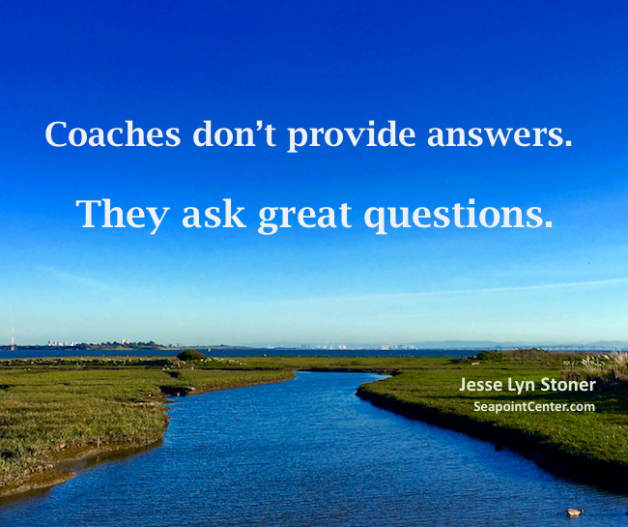
ThE power of
Great Questions

Slide 32

Lunch
12:00-12:30
12:00-12:30

Slide 33
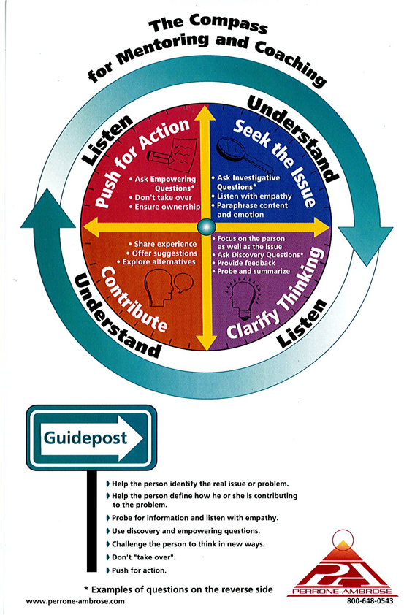
Introduction to the Coaching Compass
Seek the Issue
Clarify Thinking
Contribute
Push for Action

Slide 34


Guidepost
&
Strategy Questions
GUIDEPOST
Guidepost principles help with a deeper understanding of how to use the compass.
Strategy questions help us to be more strategic in our coaching
Try to think of your own questions in each category: These will get you started

Slide 35



Coaching Compass Practice
Compass
Practice
Introduce Quadrant
Practice
Share
Seek the Issue
Clarify Thinking
Contribute
Push for Action
Turn to the person next to you and practice using the following scenario
Please volunteer to share your experience
☺

Slide 36

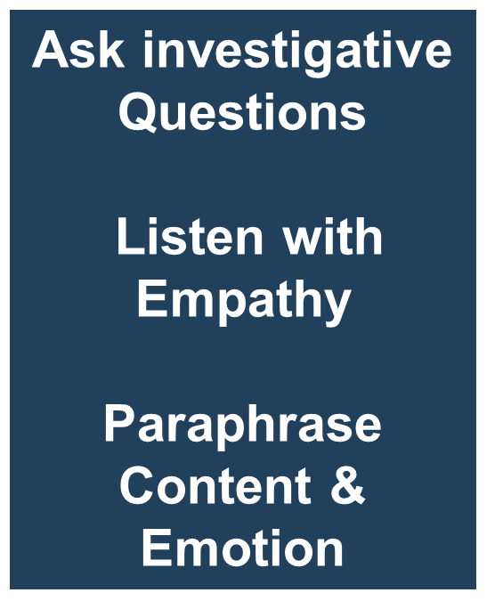

Seek the Issue
Seek
The Issue
Clarify Thinking
Contribute
Push for Action

Slide 37

Clarify Thinking
Focus on the Person as Well as the Issue
Ask Discovery Questions
Provide Feedback
Probe & Summarize
Seek
The Issue
Clarify Thinking
Contribute
Push for Action

Slide 38

Contribute
Seek
The Issue
Clarify Thinking
Contribute
Push for Action
Share Experiences
Offer Suggestions
Explore Alternatives

Slide 39

Push for action
Seek
The Issue
Clarify Thinking
Contribute
Push for Action
Ask Empowering Questions
Refrain from Taking Over
Ensure Ownership

Slide 40

Coaching Demonstration
1 -Volunteer Coach
1 -Volunteer Coachee
Group will be Observers
All 4 skills will be demonstrated together
When you hear the “chime” we will stop action for responses

Slide 41

Break

Slide 42



Slide 43

Self-Directed Work
Check In
Coaching Skill
Essential Function
Practice
Makes
Permanent
Self-Directed

Slide 44

Desired Outcomes for Todays Session
Introduction to Coaching for Leaders
Connect the concept/belief that “coaching” is key to new learning and sustainability
Learn key definitions and link to Family Success Center Culture and Practice Profile
Introduction to and beginning foundation practice of Coaching skills
Connect Coaching skills to Self-Directed learning

Slide 45

Thank you
Sean Murphy: Assistant Director of Practice
Lisa Gallagher: Executive Director

